Slide 1

Chief Executive Officer - Giles Munn
Chief Operating Officer - Charlie Parker
Vice President of Marketing - Dominik Bladek
Chief Financial Officer - Andreas Klitis

Slide 2
Overview
Our application is place where art lovers can find, discuss, comment, like or dislike art pieces.
The users will be able to display their art where they will receive ratings and comments. The application will provide a guide to the "world of art" for all art enthusiasts.
Art lovers will be able to see prices in a lot of different currencies for their favourite art pieces and contact potential sellers or buyers. Users can feel free to comment on the art or on the price of the art piece and give feedback about the quality of the art.
It will be a place where art lovers feel like they're home.

Slide 3

User Personas
Barry is a 57 year old gardener who binge watched bargain hunt over the weekend and has decided to become an amateur art dealer.
He is looking to buy pieces from up and coming artists who may become the next Picasso so that he can sell them for profit to contribute to his retirement fund.

Slide 4

Antoinette-Clementine is a Coffee Artisan who writes words like 'love', 'hate' and 'pretentious' in different sizes and colours to convey their complex emotional struggles.
They want to share their art with the world and sell pieces to eventually make enough money to achieve their dream of owning a hot air balloon shaped like a coffee bean and ballooning across the Far East.

Slide 5

Marilyn has many negative opinions they regularly need to express and their friends have gotten sock of hearing about them, so they have resorted to becoming an art critic who crushes the hopes and dreams of aspiring artists in their spare time.

Slide 6
Requirements
Users must be able to:
View artwork
Rate artwork
Comment on artwork
Create an account
Edit/Delete their account
View latest news from company
Search artwork by tags
Sort artwork by categories
Change currency of artworks
Upload pictures of their artwork
Upload profile pictures

Slide 7
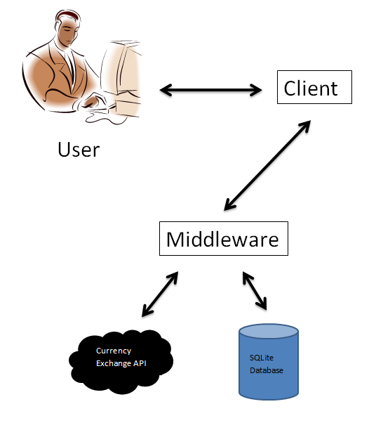
System Architecture

Slide 8
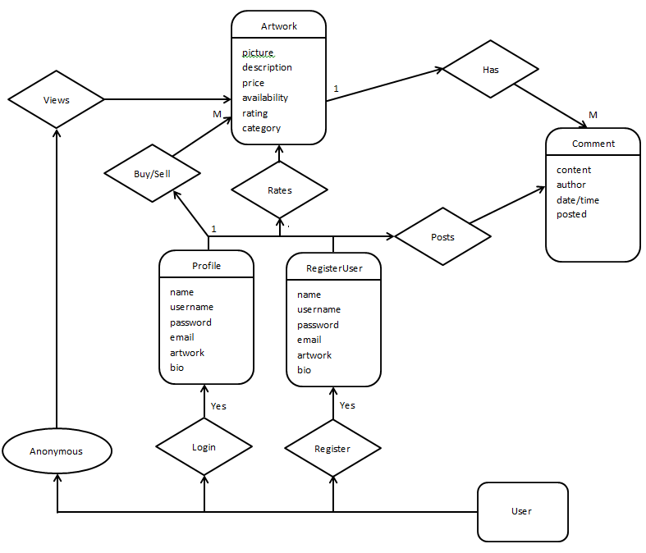
ER Diagram

Slide 9
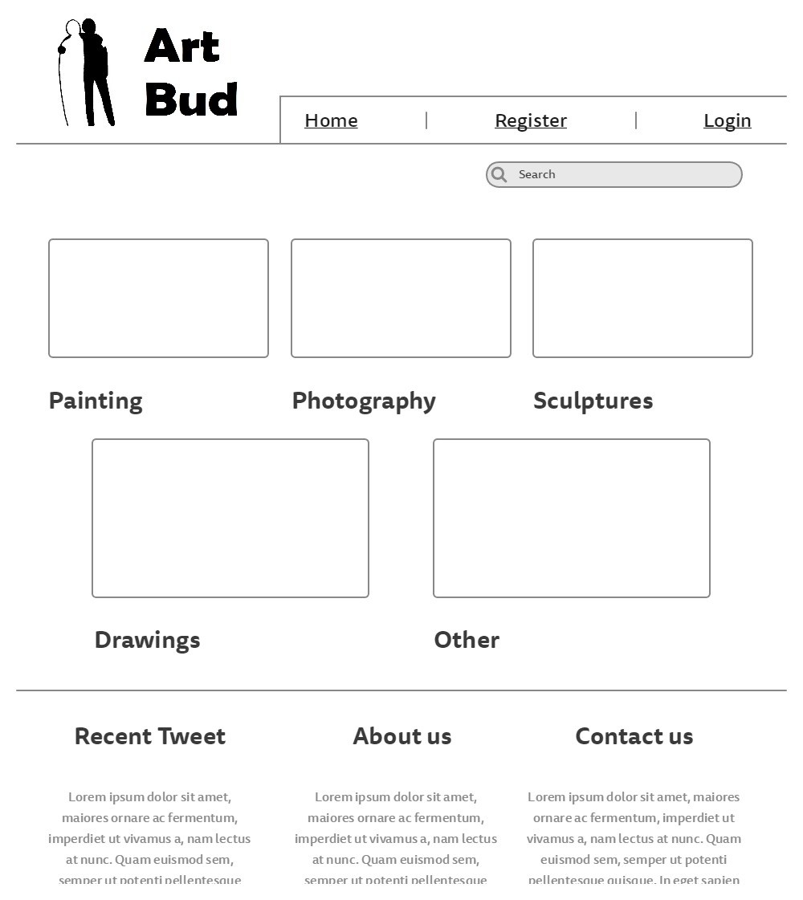
Wireframes

Slide 10
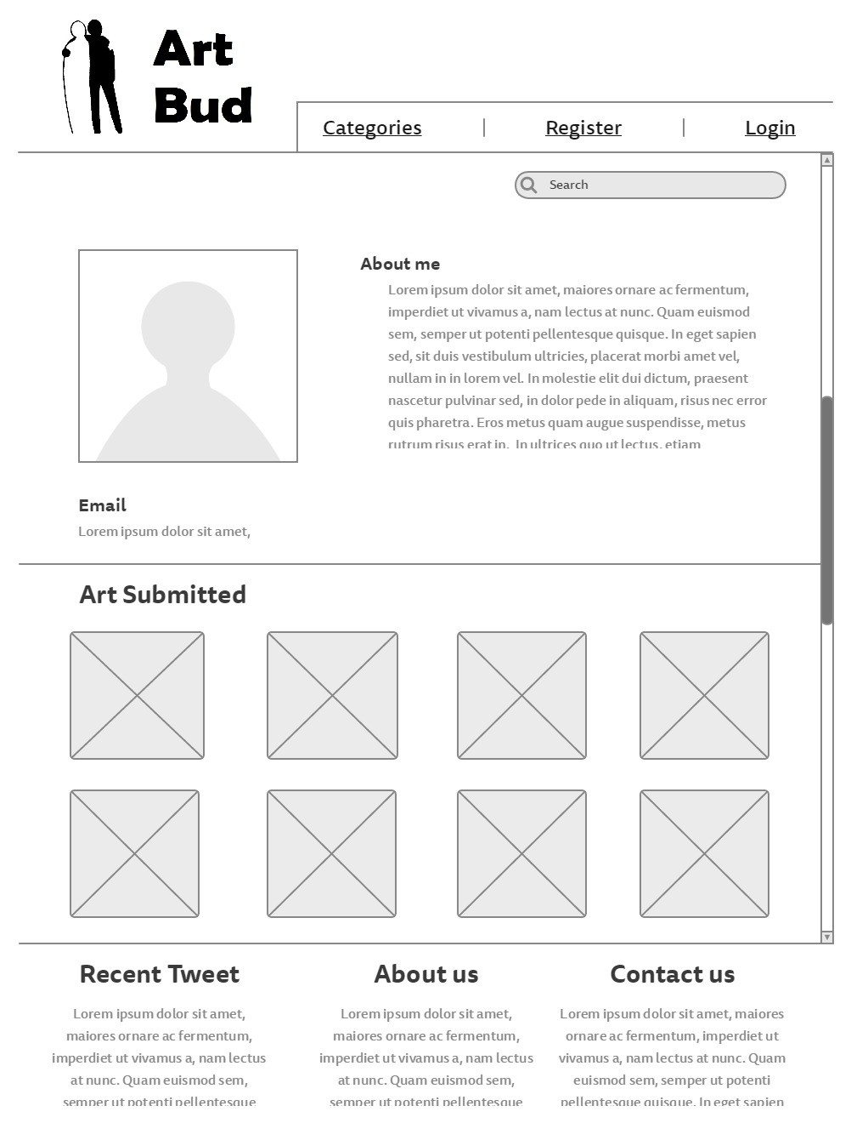

Slide 11
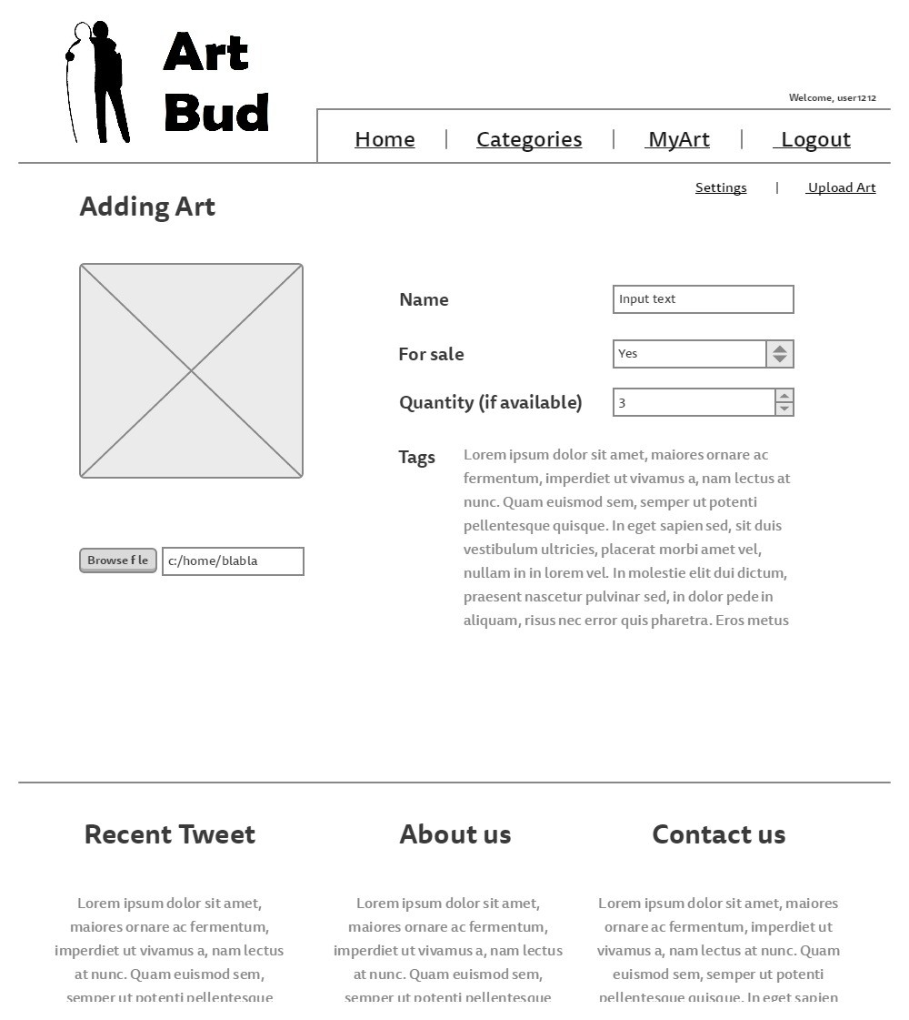

Slide 12
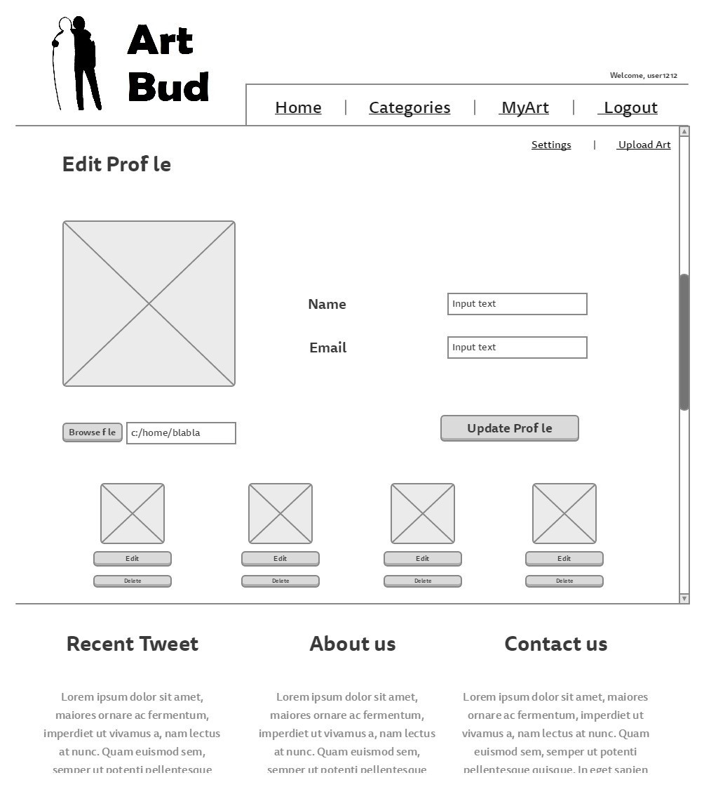

Slide 13
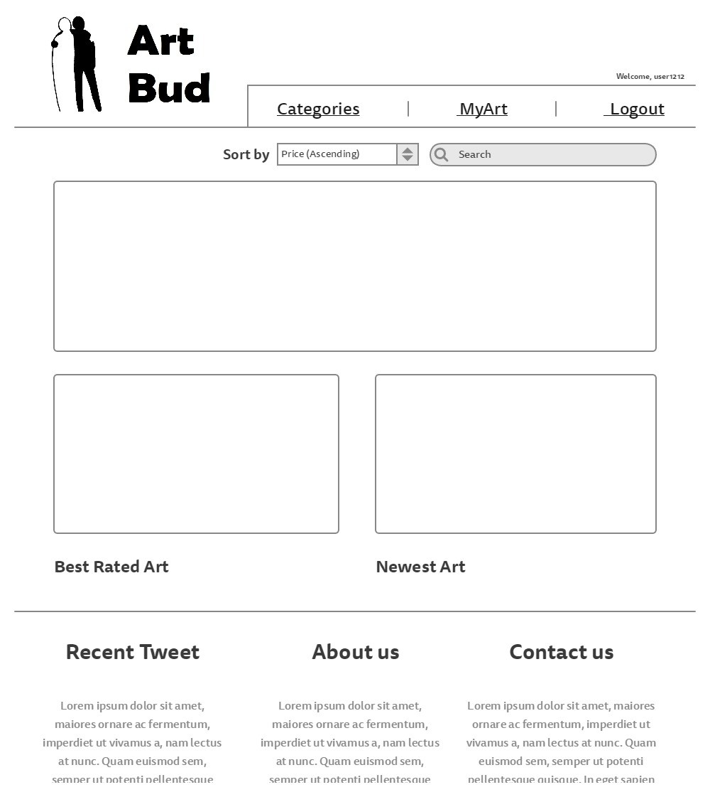

Slide 14
Site URLS
/home
/site-news
/about
/index
/contact-us
/view
/view/{{username}}
/login
/login/myaccount
/login/myaccount/upload
/login/myaccount/settings
/login/myaccount/settings/{{artname}}
/categories
/categories/painting
/categories/photography
/categories/sculptures
/categories/drawings
/categories/other

Slide 15
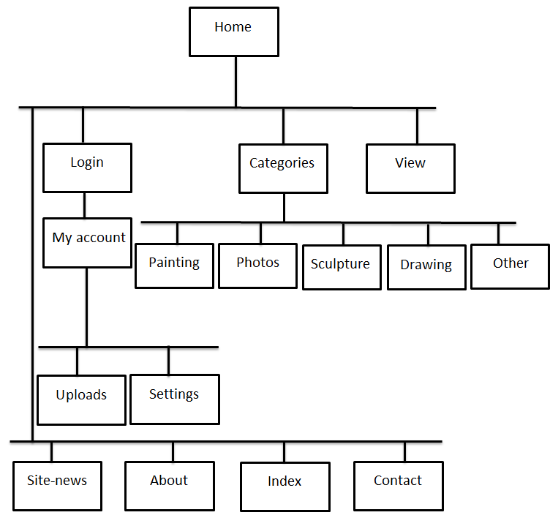
Site Map

